Slide 1

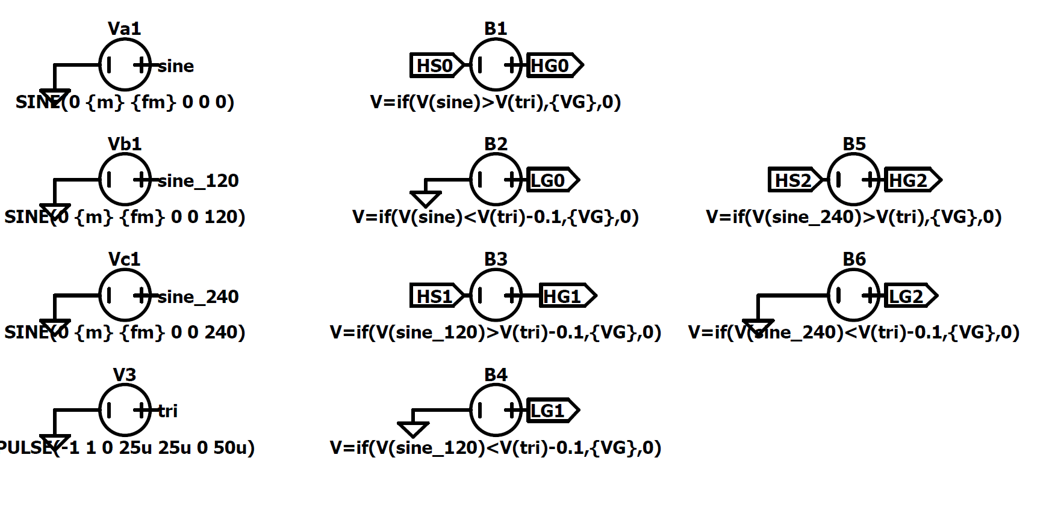
Gate Driver Hardware – IR2110

